Slide 1
HEART ATTACK PREDICTION USING MACHINE LEARNING
Mentored By:
Subhajit Bhowmik
Submitted By:
Md Irshad
Nishant Shrivastava
Vishnu Kumar
Satyam Anand
Mithlesh Yadav

Slide 2
ABSTRACT
Cardiovascular disease is one of the most fatal conditions in the present world.
Statistical data display the lethality of this disease by revealing the percentage of deaths worldwide caused due to heart attacks.
Thus, there is an implicit necessity to predict the condition at the earliest.
By utilizing the patients medical records, a new system is proposed to predict the chances of a person encounters with ‘Heart Attack’.
Variables such as Age, Sex, Blood Pressure, Heart Rate, Cholesterol Level etc. are fed into this model which is used to predict the risk of person having Heart Attack.
Our model is based on SVM (Support Vector Machine) Algorithm which has given the highest accuracy among other algorithms.
The model gives a result in either 0 or 1 format where 0 is Risk and 1 is No Risk.

Slide 3
INTRODUCTION
Heart diseases is one of the main reasons for death worldwide.
Among which 80% of the deaths are due to heart attack.
Detection of cardiac abnormalities at the early stages can save a lot of life and can help doctors to design an effective treatment plan which ultimately reduces the mortality rate due to heart attacks.
We have used medical datasets of real patients which was available at the open source by healthcare industries and survey organizations.
Data mining provides a number of techniques which discover hidden patterns or similarities from those data.
Machine Learning is a discovery method for analysing big data from an assorted perspective and encapsulating it into useful informations.

Slide 4
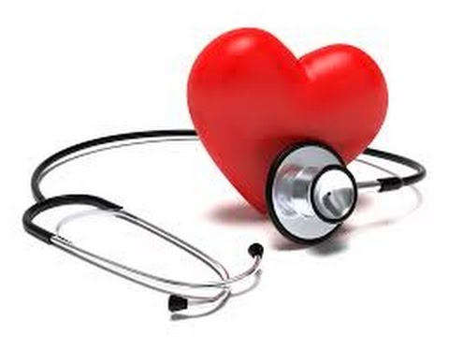
We chose this project because we wanted to utilize our skills of Machine Learning and Internet of Things.
We built a machine learning model which is the core of this project.
Sensors collect data from patients and our machine learning model analyses those data and produces a result whether that person is having a risk of heart attack or not.
After finishing things up, we will perform some testing to the web application and we are making it to be stored at cloud server.
Fig 1

Slide 5
PROJECT BLOCK DIAGRAM
User
Sensors
Machine
Learning
Model
Cloud Server
Fig 2

Slide 6
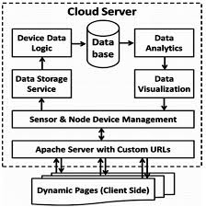
We will take some data from users through some sensors.
After analysing those data, it will be sent to our Machine Learning Model.
The model then produce a result after testing and analysing from the dataset which were used to train the model.
Then the data will be saved on a cloud server.
Saving data on Cloud helps it to be safe and easy to access over a long period.
Fig 3

Slide 7
7th Semester work with Block Diagram
Medical
Dataset
Data Preprocessing
SVM Algorithm
Random
Shuffling
Training Set
Testing Set
Heart Disease Prediction
Fig 4

Slide 8
In this semester, we have prepared a machine learning model, which is the core of our project.
We have used independent available medical dataset and processed it.
After processing, we found that this dataset best suits with SVM Algorithm, which gives better accuracy rate than other algorithms like Random Forest and KN.
We shuffled our dataset and evaluated various conditions and then we used those dataset for the training of our model.
Then after, we picked some random cases and evaluated some results, which were in either 0 or 1 according to the input given.

Slide 9
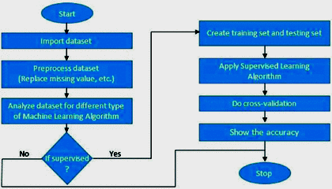
Flowchart
Fig 5

Slide 10
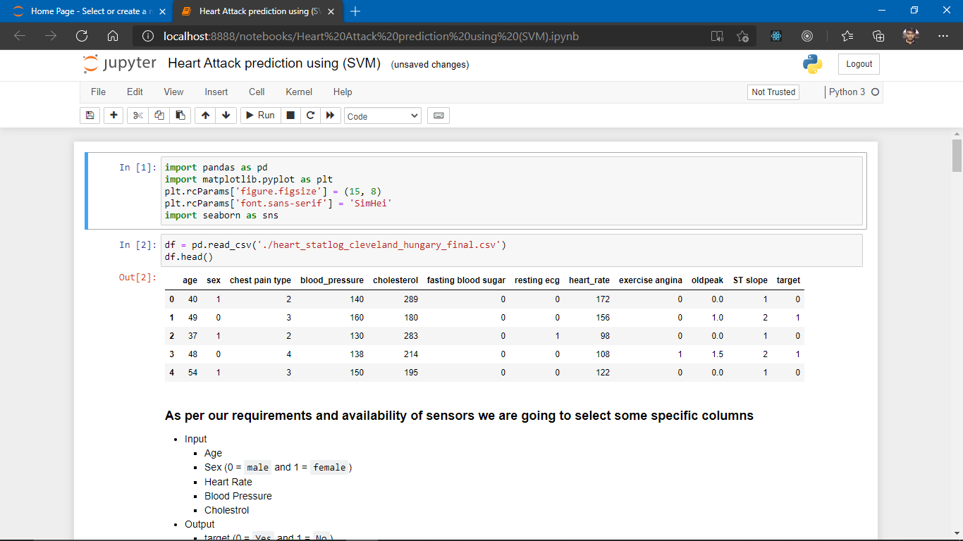
Result Sets
In the first step we gathered data from online resource to build our model to predict

Slide 11
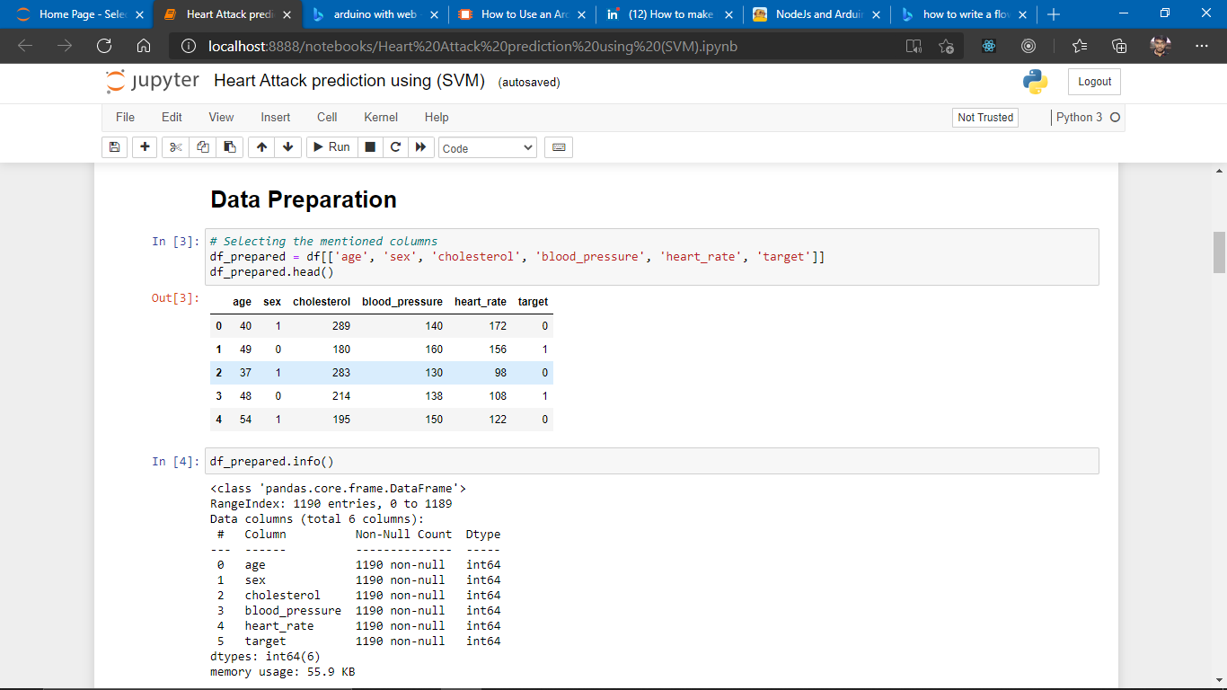
In the beginning we first eliminated some attributes which we cannot calculate.
After reducing the datasets it became easy to analyze

Slide 12
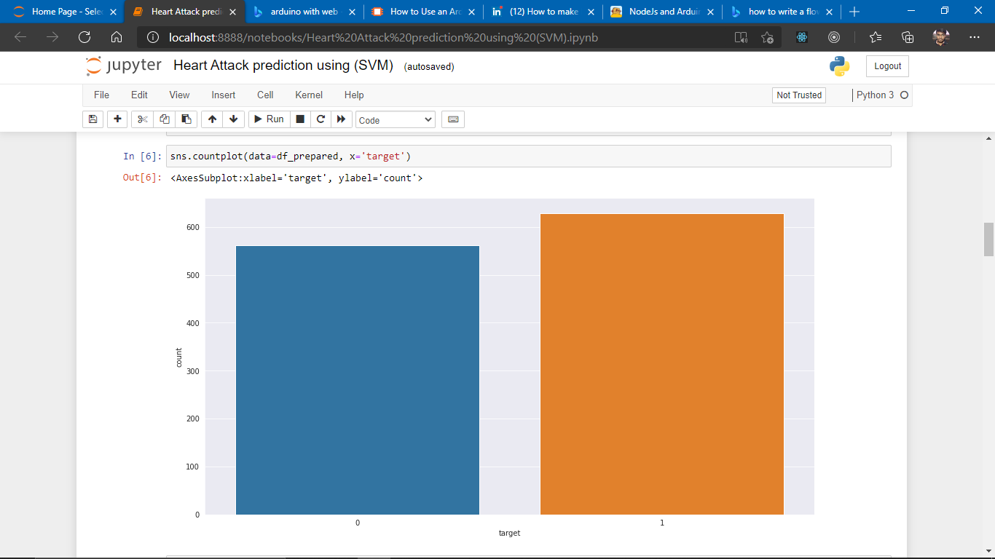
There is no missing data points and we have choose some data points which are relevant to us.
Data Analysis
By Performing analysis we found that data is not much gender biased it’s distribution is quite acceptable for prediction

Slide 13
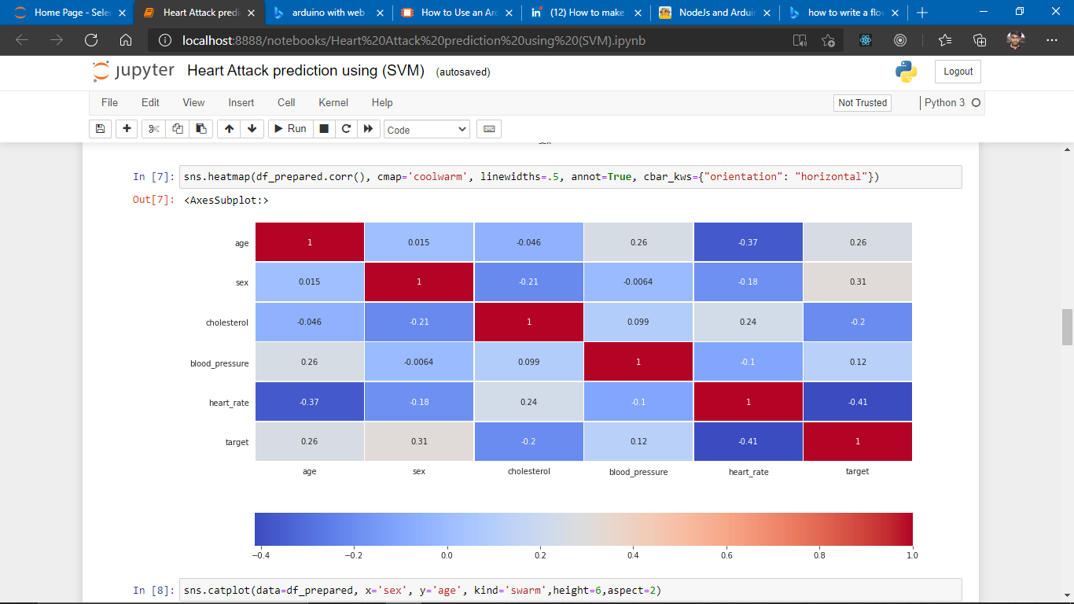
Visualizing Correlations
Heat-map calculated by taking Pearson's coefficient as [-1, 1]
Using these types of graphs we can say which attribute is correlated more or less with other attribute or is there any particular relationship. For example blood pressure has a little amount of impact in heart attack

Slide 14
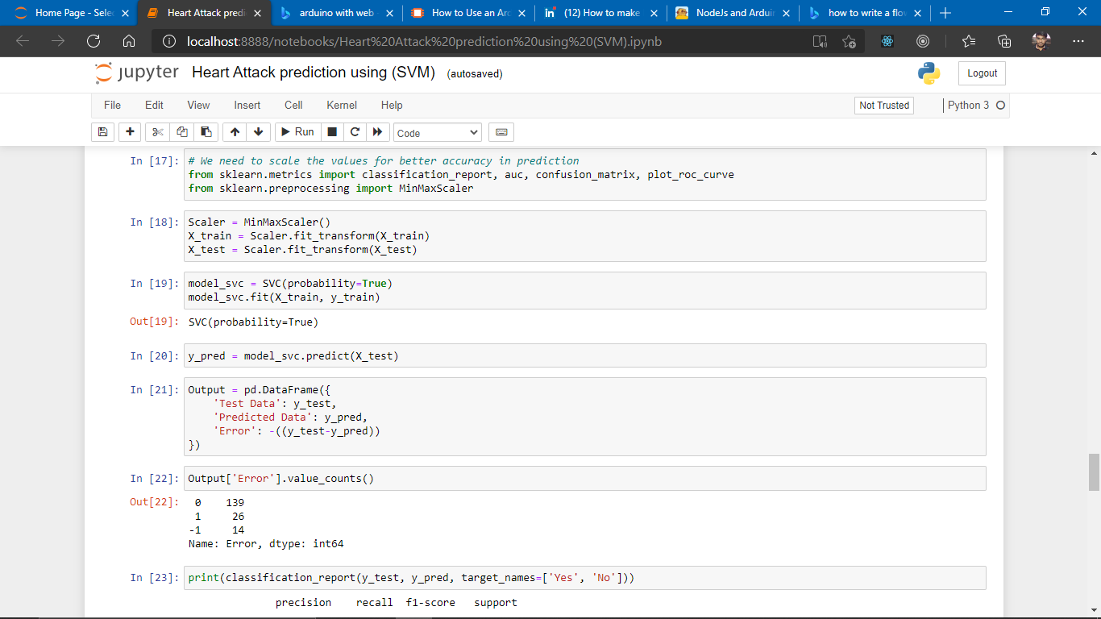
Choosing ML model Support Vector Machines (SVM)
In order to work with data points we need to scales those points within the range of -1 and 1. For the ease in calculation and correct prediction

Slide 15
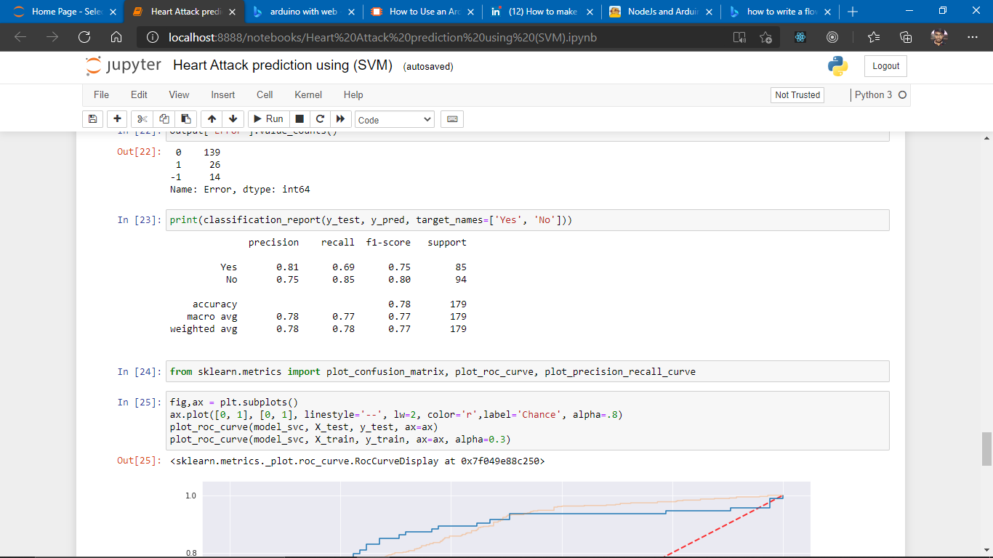
Classification Report
We can see that precision of predicting the attribute Yes is more than that of No and the accuracy of our model is also acceptable as we have less data right now.

Slide 16
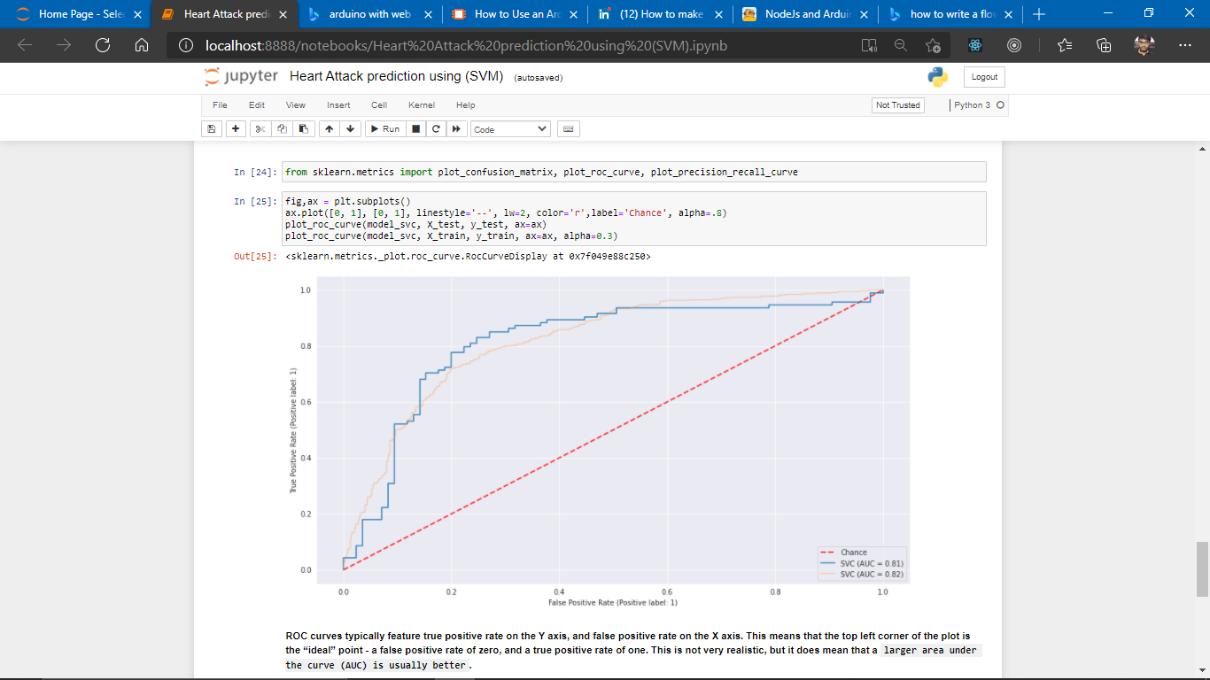
ROC-AUC Curve
Our training and testing data are somewhat working the same as we are expecting from our calculation.

Slide 17
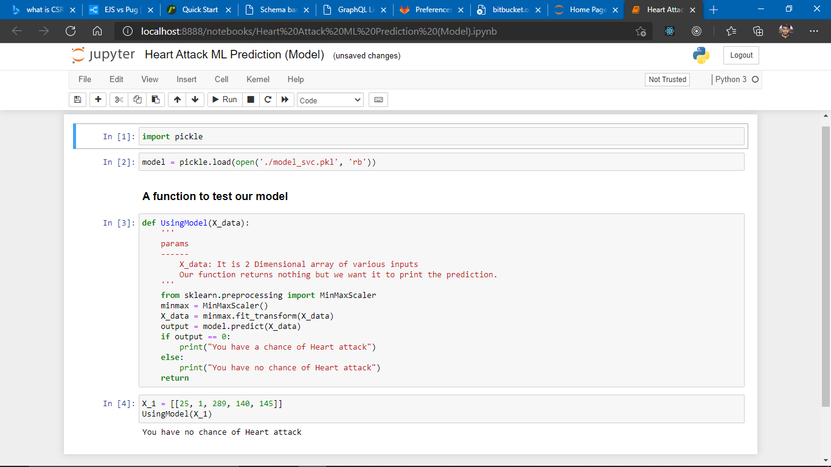
Testing out the model
Our model prediction accuracy is good enough as the data grows up model needs to be re-tuned.

Slide 18
Discussion
In the beginning we have small amount of data so our work is not that complicated but as soon the data will grow we would require to upgrade a lot of things as everything will become more complex to handle like the performance of model will decrease after every use.
There were various variables which should be selected because it plays some vital roles in so many cases but since our project is a model, we took only those variables, on which our model depends more.
Well in terms of hardware, we can also choose other resources like Raspberry Pi which would be good for our project but the fact is that, due to less accessibility, we are using Arduino with a Wi-Fi board in upcoming semester.
If this project raises upto our expectations, then we will consider all the points and try to find an optimal solution to both hardware and software resources and also increase the number of variables and sensors.

Slide 19
Future Work
Hardware Development
Arduino program
Web Application (Frontend and Backend)
Deployment

Slide 20
References and Bibliography
Sample References:
1. M. Sanjeev Arulampalam, Simon Maskell, Neil Gordon, and Tim Clapp, “A tutorial on
particle filters for online nonlinear/non-Gaussian Bayesian tracking”, IEEE Transactions
on Signal Processing, Vol. 50, No. 2, pp:174-188, Feb’ 2002.
2. R. N. Banavar, J. L. Speyer, “Properties of Risk-Sensitive Filters/Estimators”, IEEE
Proceedings of Control Theory Application, Vol.145, No. 1, January 1998.
3. R. G. Brown, and P. Y. C. Hwang, Introduction to Random Signals and Applied
Kalman Filtering with Matlab Exercises and Solutions, 3rd Edition, John Wiley & Sons,
Inc, 1997.
4. Universal Description, Discovery and Integration, UDDI ; http://www.uddi.org; October
5, 2007.

Slide 21
Code
# We need to scale the values for better accuracy in prediction
from sklearn.metrics import classification_report, auc, confusion_matrix, plot_roc_curve
from sklearn.preprocessing import MinMaxScaler
Scaler = MinMaxScaler()
X_train = Scaler.fit_transform(X_train)
X_test = Scaler.fit_transform(X_test)
model_svc = SVC(probability=True)
model_svc.fit(X_train, y_train)
y_pred = model_svc.predict(X_test)
print(classification_report(y_test, y_pred, target_names=['Yes', 'No']))
from sklearn.metrics import plot_confusion_matrix, plot_roc_curve, plot_precision_recall_curve
fig,ax = plt.subplots()
ax.plot([0, 1], [0, 1], linestyle='--', lw=2, color='r',label='Chance', alpha=.8)
plot_roc_curve(model_svc, X_test, y_test, ax=ax)
plot_roc_curve(model_svc, X_train, y_train, ax=ax, alpha=0.3)
plot_confusion_matrix(model_svc, X_test, y_test)
import pickle
# Saving the model
filename='model_svc.pkl'
pickle.dump(model_svc, open(filename, 'wb'))
df_prepared.to_csv('prepared_data.csv', index=False)

Slide 22


